Slide 1
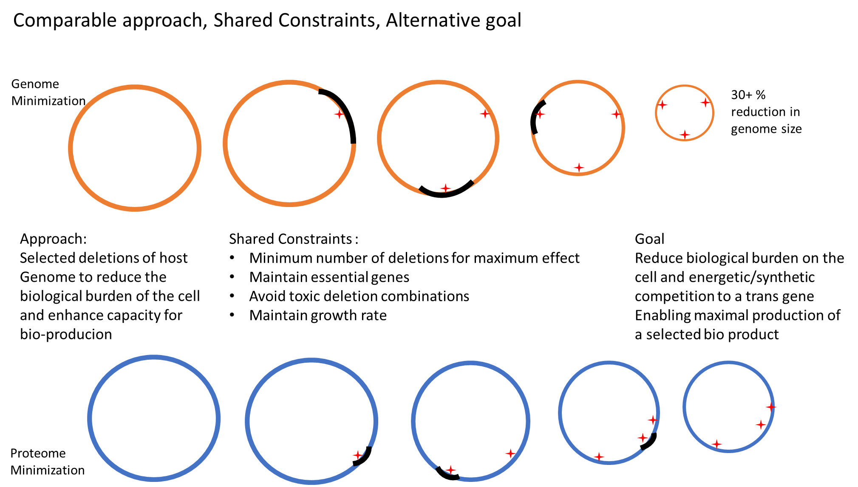
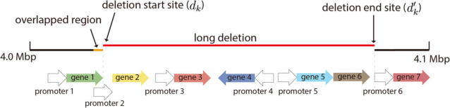
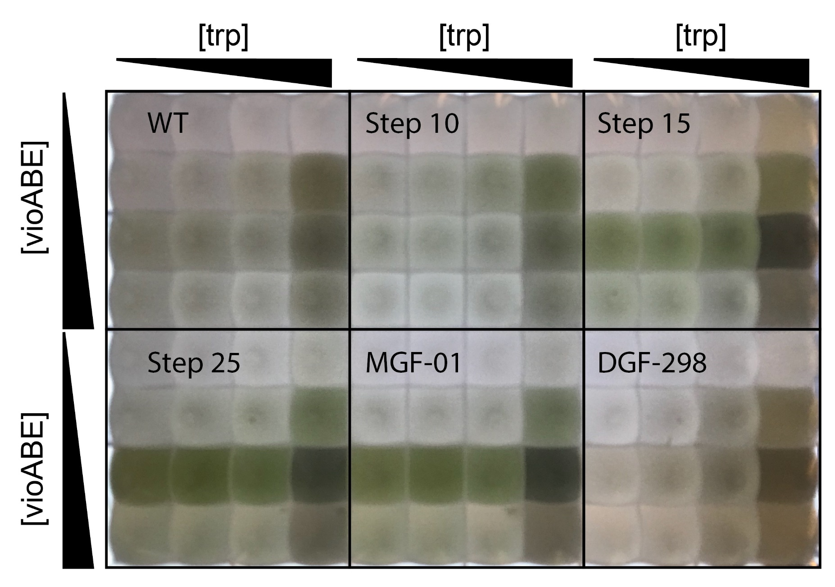

Optimal Protein Reclamation with MaxMass
Making Room for Bioproduction via Intelligent Reduction of the Host Proteiome
Jeremy Zucker, Neeraj Kumar, Jeremy Teuton
Introduction/Motivation:
In this here text box we write out the details of the project with each section called out (motivation of minigenome- mini-proteome for max mass recovery (LEFT) deletion diagram (below) protein allocation of host (RIGHT) in this way the text acts as figure legend and is redundant/expands on the visual explanation taking up the whole top 1/3 of the poster
Results:
Figure to the left of this box legend fully explaining what we are seeing
Figure to the left of this box legend if needed
Figure to the left of this box legend if needed
Discussion/Future Directions:
Methods:
Questions?
MaxMassReclamation is the MinGenome(citation) algorithm with the following modified objective function:
max∑k∈Kyk∑i=1kmi−∑k∈Kxk∑i=1kmimax∑k∈Kyk∑i=1kmi−∑k∈Kxk∑i=1kmi
where mimi is the measured protein mass of gene ii and ∑ki=1mi∑i=1kmi is the cumulative protein mass of all genes from the origin of replication to the kkth gene. Since ∑k∈Kxk=1∑k∈Kxk=1 and By subtracting the cumulative protein mass of the start gene from the cumulative protein mass of the end gene, we obtain the cumulative protein mass of the interval for the optimal solution
We maximize the mass that is knocked out based on absolute quantitative proteomics Schmidt et al 2015 in (fg/cell)(fg/cell)
We then run Max mass reclamation iteratively without replacement.
Instead of maximizing the length of the knockout,
max∑k∈Kykd′k−∑k∈Kxkdk
Any genes that were knocked out in one of the KHK steps and never appears in the iBAQ dataset, so can we assume its wild-type expression is 0? It is not in the iBAQ dataset, but it is in the list of KHK knockouts.
If it is not in the data frame, then it was not observed. This is common in proteomics. We only observe some fraction of the proteins in any given experiment. The typical answer is that the others are below the limit of detection. I am not sure how you want to encode that for your analysis, but their abundance is presumed to be zero/low.
I know that iBAQ values are not comparable across conditions, but are they comparable across replicates?
I can use iBAQ to compare across different conditions, but we need to keep in mind that this method has a larger error because it include all detected peptides, including some that very variable and less reliable for quantification. It was estimated that the error in iBAQ is about 2 folds.
i.e. is it valid to calculate the molar percentage of the mean of 3 replicates, or do I need to calculate the molar percentage individually for each replicate and then take the mean?
Given molar percentage measurements from step N, run MaxMass (our modified version of MinGenome) using those molar percentages to predict which genes should be knocked out in step N+1. Compare our MaxMass predictions with the choice of actual step N+1 and MinGenome step to see how similar they are
Take the iBAQ measurements for step N, remove all genes that were knocked out in actual step N+1 and recalculate the molar percentage. Compare with actual molar percentages in step N+1 using KL divergence
DKL(P∥Q)=−∑iP(i)logQ(i)P(i)DKL(P∥Q)=−∑iP(i)log⁡Q(i)P(i)
or even more simply the Euclidean distance metric
D2(P,Q)=∑i∥P(i)−Q(i)∥2D2(P,Q)=∑i∥P(i)−Q(i)∥2
where PP is the actual molar percentages and QQ is the predicted molar percentage. This gives us a measure of how much protein expression changed as a result of the knockouts. If DKL=0DKL=0 then it is an exact match. If it is greater than This doesn't tell us how much protein capacity we reclaimed, but it will give us an idea of how valid our assumptions are for using molar percentage to choose which genes to knock out.
File Name // File Date // PNNL-SA-#####
Notes:
NOTE: Print this poster file at 200% SCALE to result in a physical print measuring 60” wide x 42” tall. All type size notations shown above are based on the final printed size of the poster.
• Contact Digital Duplicating (375-2969, http://digitalduplicating.pnl.gov) to order poster printing and finishing services for your completed poster design.
• Remember to have your poster cleared for public display/distribution through the Information Release system (http://informationrelease.pnl.gov).
• Sidebar “About PNNL” box is considered optional, and can be removed if space is needed for technical content.

